Slide 1

The Startup Way
Eric Ries

Slide 2
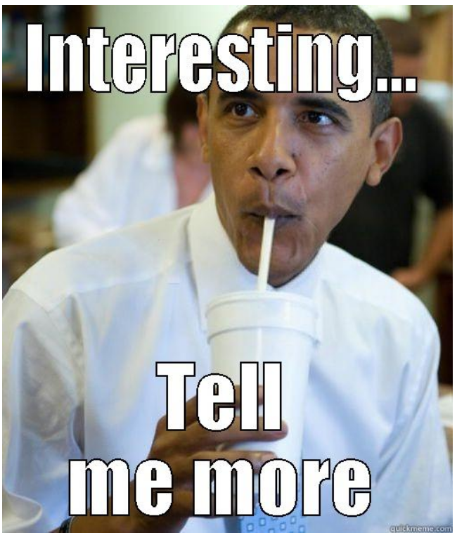
About the author
Author of Lean Starup and Startup Way
Moved to Silicon Valley as a software engineer
The first company he worked for failed
Joined hands with previous founder – IMVU
He picked up fast customer feedback by taking the investor’s class at UC Berkeley, applied it with lean programming
After success at IMVU, he joined a venture capital firm as an advisor, then became independent advisor
Lean methodology originated (Got lot of traction and invitations)
Wrote “The Startup Way” (not as successful)

Slide 3
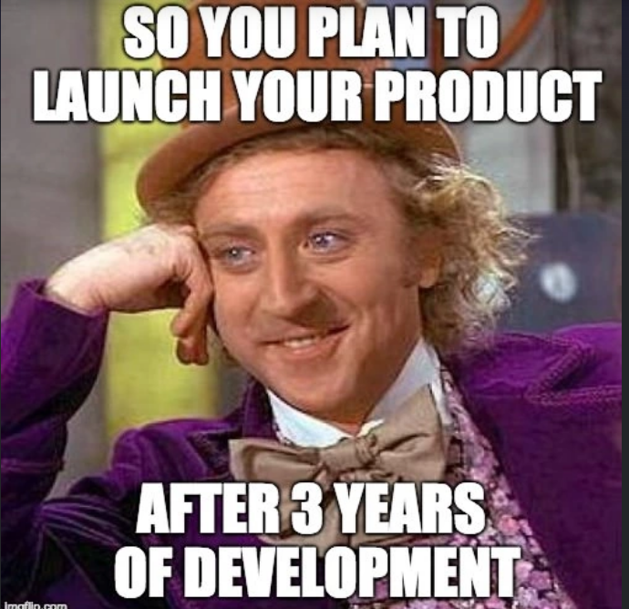
Why - The Startup Way
Do we remember why - The Lean Startup?
Aimed at what type of businesses?
What environment they operate in?
How do they get funding?
Do we think , new projects in corporate have some similarity?
Can you predict customer behaviour?
Are you sure they will buy your product?

Slide 4
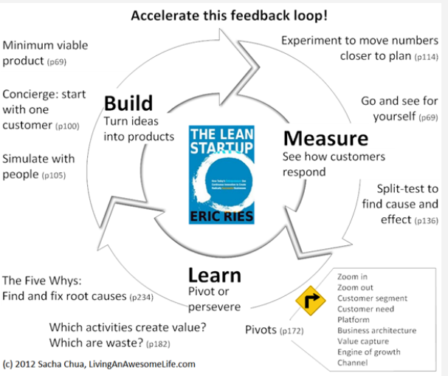
The Lean Startup Way – Apply this to all projects

Slide 5
Taking lean to corporates
Long term forecasts
Unvalidated assumptions about the customers
Middle management paid to reduce uncertainty and risks
Work 4 months, validate and pivot?
Or
Work 2 years with fantasy forecasts to realise no one is using it or will use it? Is lean a better way to kill projects?

Slide 6
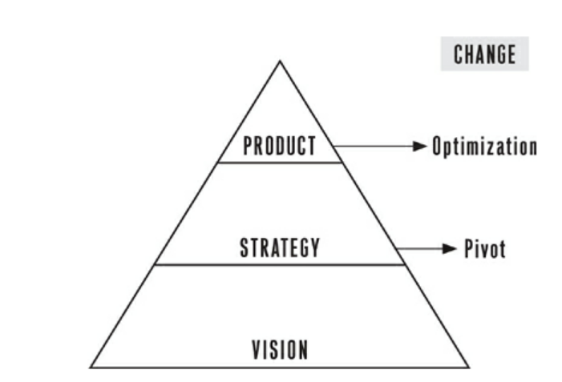
How lean startup delivers on the vision?
Vision: Creating better pathways to better health (Does not change)
Strategy (Can change) – Pivot or Perservere
Make health care affordable
Help people manage their health better
Product
Digitised apps
Recommendations
Telephonic Support
Consulting

Slide 7
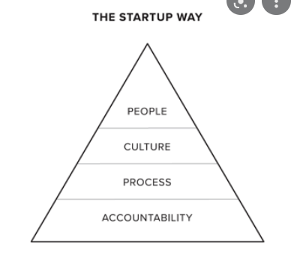
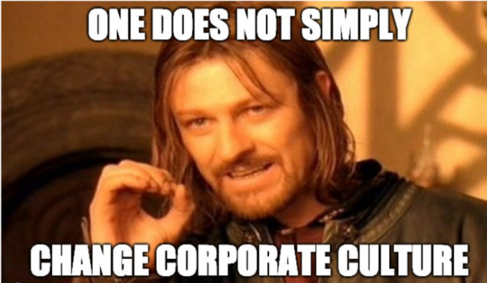
Where do we start? Lets change the culture shall we

Slide 8
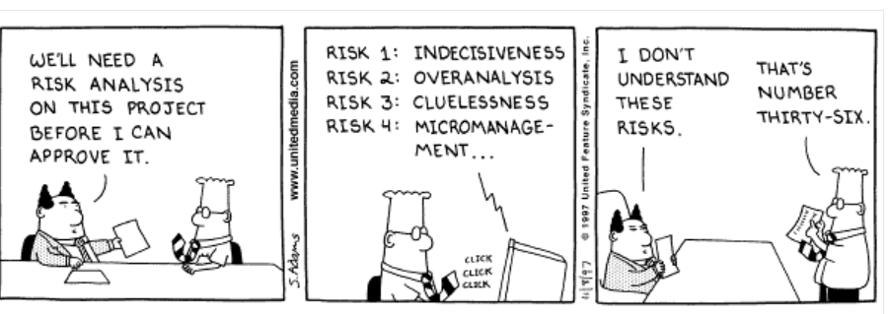
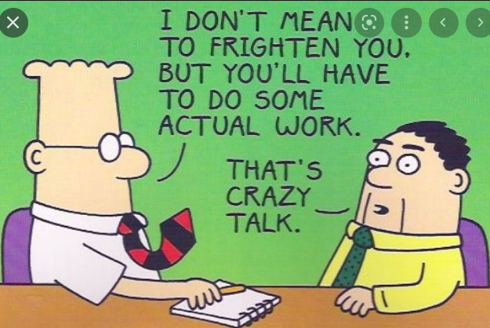
If project fails , no promotion this year

Slide 9
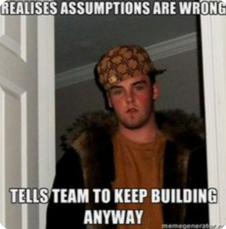
Fastest way to validate your idea?
Do people really have the problem you think they do?
How do they approach the problem today?
Is the idea better alternative for them?
Value Hypothesis | Growth Hypothesis
Does product really delights the customer | Will I get more customers
Customers want high quality whisky Customers will pay big Buck Test? | Some customers will become brand evangelists and recommend the product Existing customers will buy on special occasions and gift to others Test?

Slide 10
Three Phases of Transformation
Critical Mass (Start small and lean) – 1 Project, then few more, touch few functions
Cross Functional
Remember legal (Have them on board early, from day one of your idea)
Scaling Up
Identify true exec champions
Finding champions is not enough
There are challenges faced by first teams, identify those, and systemise the learnings Its time to market these ideas and develop in a way you get wider acceptance
Breaking processes, getting everyone to break processes and ship earlier. (Sounds dirty, but are we making another leap of faith assumption, to execs and senior leaders want to act recklessly)
Train all functions. Need to find the ones that are with the flow and also the ones that are roadblocks
In house coaching (In house led change is faced with less resistance than outside led change)
Deep systems
Payroll and employee management systems
Annual reviews

Slide 11
My perspective
Read the book, take what makes sense for us
If government can do it, medical labs can apply it, so can we
Book is loaded with concepts and examples (mind you real examples, from big bureaucratic to government to healthcare)
Is a tough read, take your time (Innovation accounting – a new way of measuring success, than traditional metrics.. Toughest read)
Start with the experiment, see if it works?

Slide 12
How could we apply it
(Critical Mass) Read by few people and couple execs
Build some traction with some projects
(Scaling up) Discuss what we learnt and how could we apply
Get everyone trained , even if they wont be directly involved
(Deep systems) For us maybe the corporate style is not ingrained yet. Maybe how we are used to work previously

Slide 13
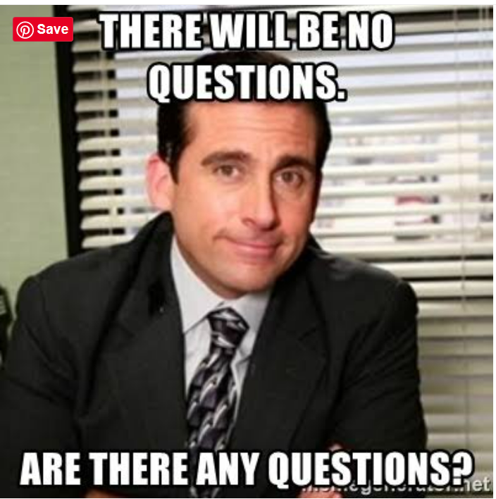
Questions

